Slide 1
Novel Theoretical Model for Optimal C₄ Photosynthesis
Helen Scott

Slide 2
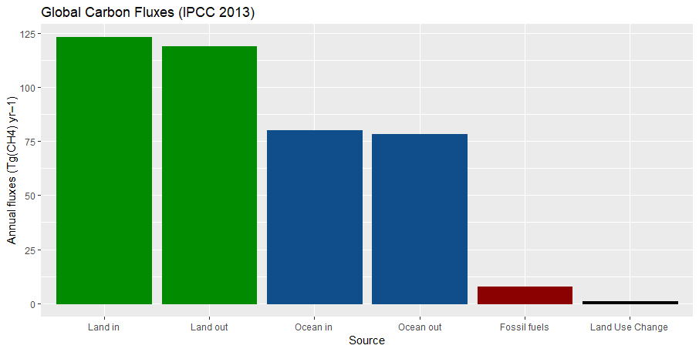
Modeling Photosynthesis is Important
Food Security & Climate Change | Introduction to Photosynthesis | Modeling Acclimation | Model Applications
Helen Scott | ESA & USSEE 2019 | August 13, 2019

Slide 3
Modeling Photosynthesis is Important
Food Security & Climate Change | Introduction to Photosynthesis | Modeling Acclimation | Model Applications
Photosynthesis
Helen Scott | ESA & USSEE 2019 | August 13, 2019

Slide 4
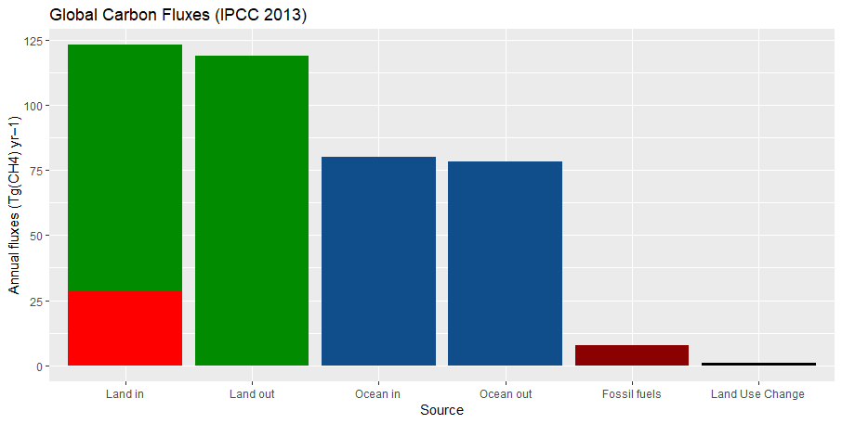
C4 photosynthesis is important
Food Security & Climate Change | Introduction to Photosynthesis | Modeling Acclimation | Model Applications
C4s
Helen Scott | ESA & USSEE 2019 | August 13, 2019

Slide 5
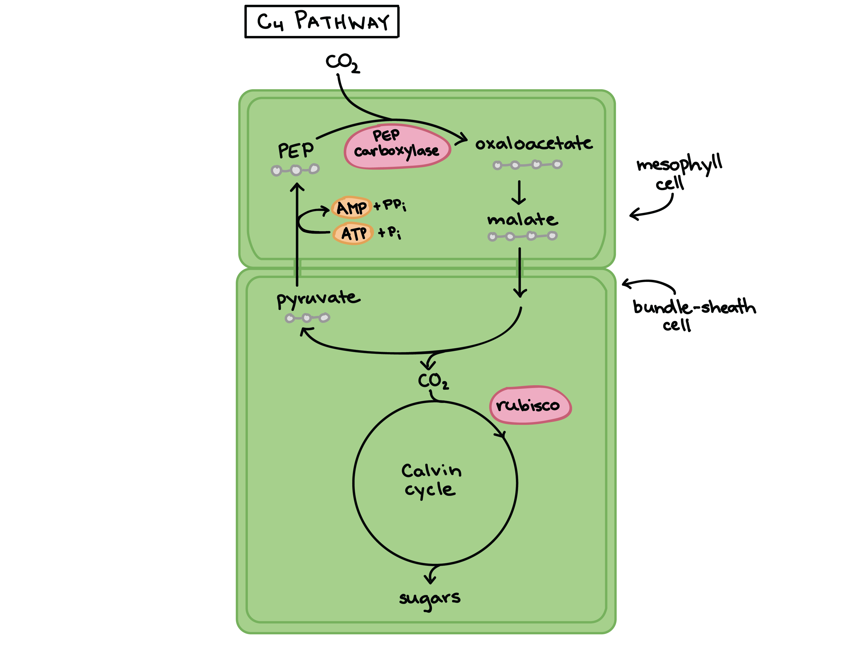
How does photosynthesis work?
Food Security & Climate Change | Introduction to Photosynthesis | Modeling Acclimation | Model Applications
Helen Scott | ESA & USSEE 2019 | August 13, 2019

Slide 6
C₄ photosynthesis
Food Security & Climate Change | Introduction to Photosynthesis | Modeling Acclimation | Model Applications
Helen Scott | ESA & USSEE 2019 | August 13, 2019

Slide 7
C₄ photosynthesis
Food Security & Climate Change | Introduction to Photosynthesis | Modeling Acclimation | Model Applications
C4 crops are 40% more productive than C3 crops!
Helen Scott | ESA & USSEE 2019 | August 13, 2019

Slide 8
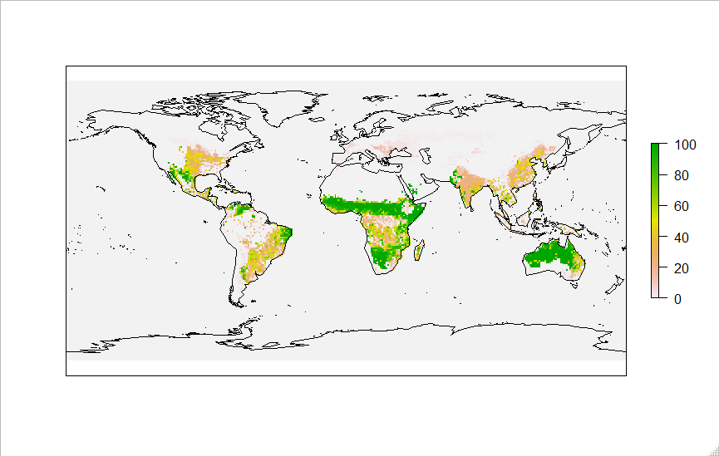
Where you find C₄ plants

Slide 9
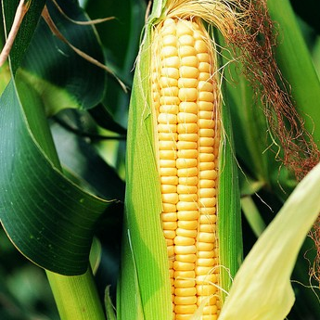
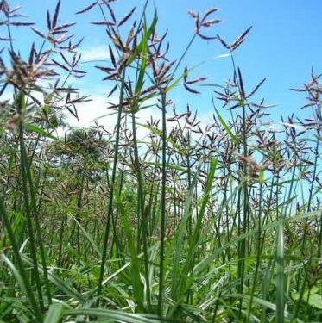
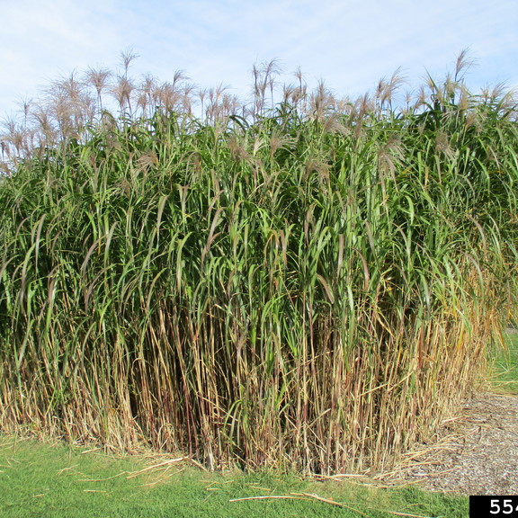
C₄ plants are important
Food Security & Climate Change | Introduction to Photosynthesis | Modeling Acclimation | Model Applications
Crops
Weeds
Biofuels
Helen Scott | ESA & USSEE 2019 | August 13, 2019

Slide 10
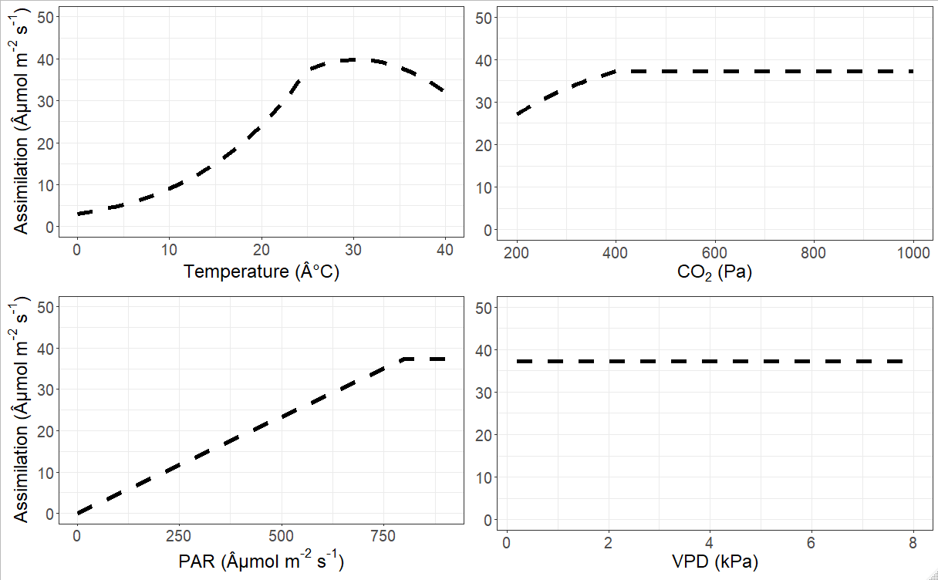
What we know well: Short term responses
Food Security & Climate Change | Introduction to Photosynthesis | Modeling Acclimation | Model Applications
Helen Scott | ESA & USSEE 2019 | August 13, 2019

Slide 11
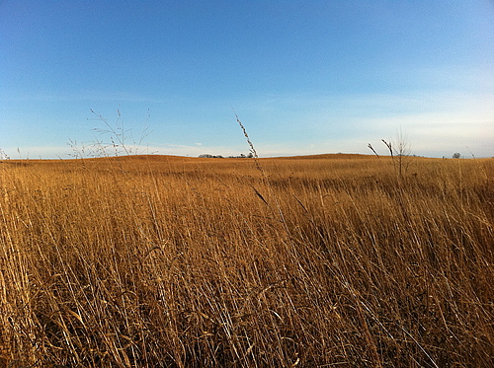
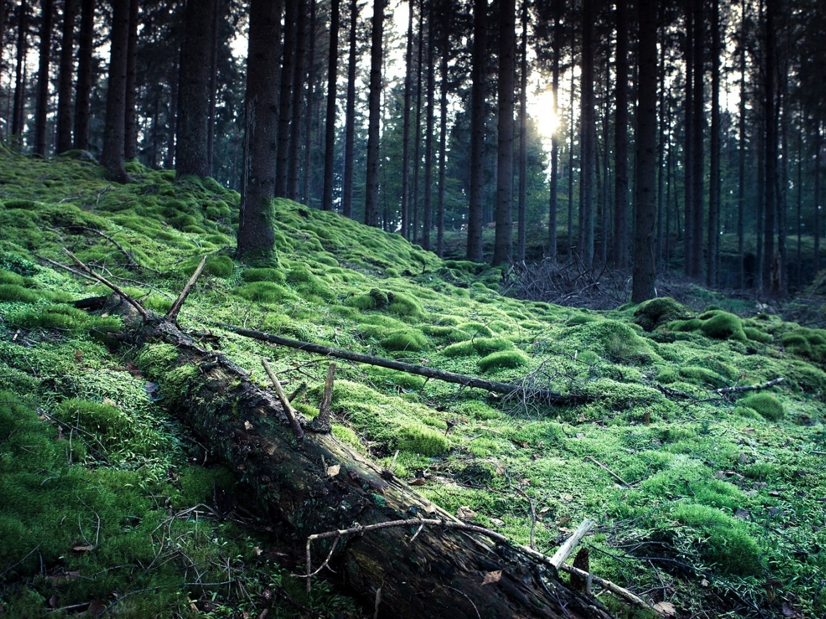
Acclimation happens
Food Security & Climate Change | Introduction to Photosynthesis | Modeling Acclimation | Model Applications
High Light
vs
Low Light
Helen Scott | ESA & USSEE 2019 | August 13, 2019

Slide 12
Acclimation happens
Food Security & Climate Change | Introduction to Photosynthesis | Modeling Acclimation | Model Applications
High Light
vs
Low Light
15
15
10
10
Photosynthesis
5
5
A_{L}
A_{C}
0
0
250
500
750
1000
250
500
750
1000
Light
Light
Helen Scott | ESA & USSEE 2019 | August 13, 2019

Slide 13
The Goal
Food Security & Climate Change | Introduction to Photosynthesis | Modeling Acclimation | Model Applications
Calculate net photosynthesis of acclimated C4 plants from environmental conditions without additional parameterization.
Helen Scott | ESA & USSEE 2019 | August 13, 2019

Slide 14
Coordination Hypothesis
Food Security & Climate Change | Introduction to Photosynthesis | Modeling Acclimation | Model Applications
ETR limited
Carboxylation limited
Photosynthetic rate
Light
Helen Scott | ESA & USSEE 2019 | August 13, 2019

Slide 15
Coordination Hypothesis
Food Security & Climate Change | Introduction to Photosynthesis | Modeling Acclimation | Model Applications
Light limited
Carboxylation limited
Photosynthetic rate
Light
Helen Scott | ESA & USSEE 2019 | August 13, 2019

Slide 16
Coordination Hypothesis
Food Security & Climate Change | Introduction to Photosynthesis | Modeling Acclimation | Model Applications
A_{L} = A_{P} = A_{C}
Helen Scott | ESA & USSEE 2019 | August 13, 2019

Slide 17
Coordination of Photosynthesis
Food Security & Climate Change | Introduction to Photosynthesis | Modeling Acclimation | Model Applications
A_{L} depends on (φ, light)
A_{P} depends on (CO₂, Temp, PEPc)
A_{C} depends on (CO₂, Temp, Rubisco)
Helen Scott | ESA & USSEE 2019 | August 13, 2019

Slide 18
Coordination of Photosynthesis
Food Security & Climate Change | Introduction to Photosynthesis | Modeling Acclimation | Model Applications
A_{L} depends on (φ, light)
A_{P} depends on (CO₂, Temp, V_{pmax})
A_{C} depends on (CO₂, Temp, V_{cmax})
Helen Scott | ESA & USSEE 2019 | August 13, 2019

Slide 19
Coordination of Photosynthesis
Food Security & Climate Change | Introduction to Photosynthesis | Modeling Acclimation | Model Applications
A_{L} depends on (φ, light)
A_{P} depends on (CO₂, Temp, V_{pmax})
A_{C} depends on (CO₂, Temp, V_{cmax})
Helen Scott | ESA & USSEE 2019 | August 13, 2019

Slide 20

Stomatal Conductance
Food Security & Climate Change | Introduction to Photosynthesis | Modeling Acclimation | Model Applications
H₂O
CO₂
Helen Scott | ESA & USSEE 2019 | August 13, 2019

Slide 21
Stomatal Conductance: Least-Cost Hypothesis
Food Security & Climate Change | Introduction to Photosynthesis | Modeling Acclimation | Model Applications
CO₂in the plant C_{i}
CO₂ in the air C_{a}
=
= χ ~ Stomatal Conductance
Water Loss
Photosynthesis
Helen Scott | ESA & USSEE 2019 | August 13, 2019

Slide 22
Stomata are Closed when it is Drier
H₂O
CO₂
0.70
0.65
Ci/Ca Ratio
0.60
0.55
0.50
1
2
3
4
Helen Scott | ESA & USSEE 2019 | August 13, 2019
Vapor Pressure Deficit (kPa)

Slide 23
Stomata are Open when Heat Drives Enzymes
H₂O
CO₂
0.7
0.6
Ci/Ca Ratio
0.5
0.4
0
10
20
30
40
Temperature (C)
Helen Scott | ESA & USSEE 2019 | August 13, 2019

Slide 24
But Heat and Aridity Go Together…
H₂O
CO₂
0.7
0.6
Ci/Ca Ratio
0.5
0.4
0
10
20
30
40
Temperature (C)
Helen Scott | ESA & USSEE 2019 | August 13, 2019

Slide 25
C₄s are More Water Efficient
0.9
0.8
0.8
0.7
0.7
Ci/Ca Ratio
0.6
0.6
0.5
C₄
C₃
0.4
0.5
1
2
3
4
0
10
20
30
40
Vapor Pressure Deficit (kPa)
Temperature (C)
Helen Scott | ESA & USSEE 2019 | August 13, 2019

Slide 26
Coordination Hypothesis
Food Security & Climate Change | Introduction to Photosynthesis | Modeling Acclimation | Model Applications
A_{L} = A_{P}
Helen Scott | ESA & USSEE 2019 | August 13, 2019

Slide 27
Coordination of Photosynthesis
Food Security & Climate Change | Introduction to Photosynthesis | Modeling Acclimation | Model Applications
A_{L} depends on (φ, light)
A_{P} depends on (CO₂, Temp, V_{pmax})
A_{C} depends on (CO₂, Temp, V_{cmax})
Helen Scott | ESA & USSEE 2019 | August 13, 2019

Slide 28
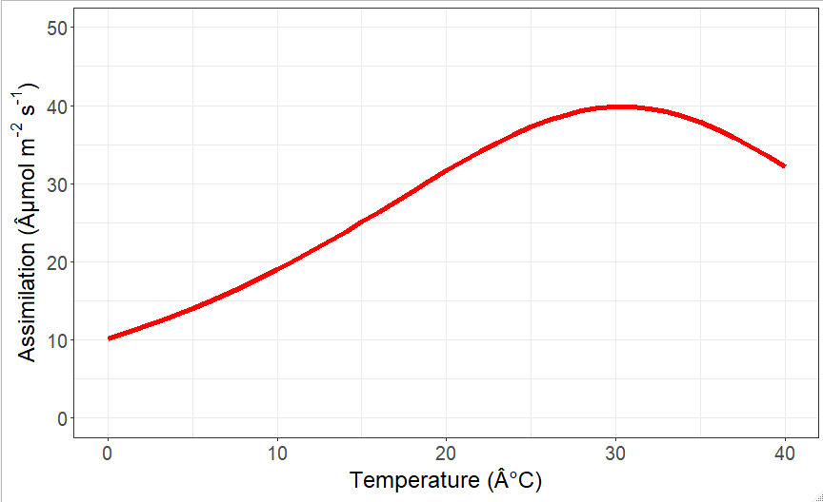
Photosynthesis Increases with Temperature
Food Security & Climate Change | Introduction to Photosynthesis | Modeling Acclimation | Model Applications
Helen Scott | ESA & USSEE 2019 | August 13, 2019

Slide 29
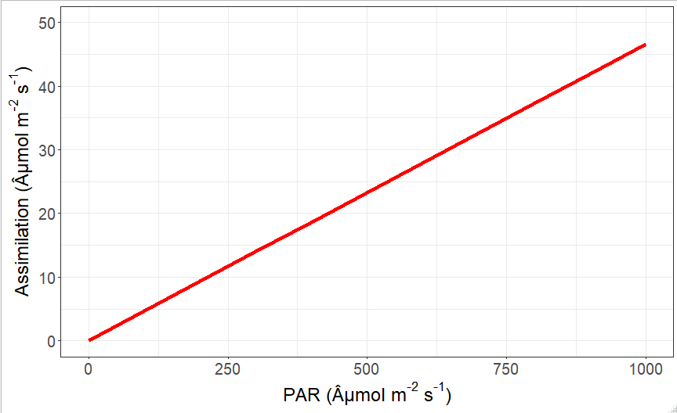
Photosynthesis Increases with Light
Food Security & Climate Change | Introduction to Photosynthesis | Modeling Acclimation | Model Applications
Helen Scott | ESA & USSEE 2019 | August 13, 2019

Slide 30
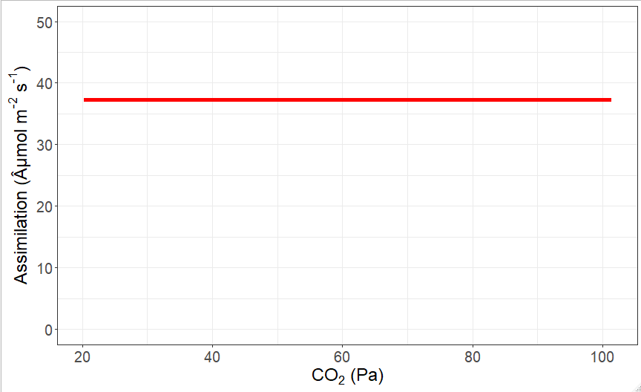
Photosynthesis Stays the Same with CO₂
Food Security & Climate Change | Introduction to Photosynthesis | Modeling Acclimation | Model Applications
Helen Scott | ESA & USSEE 2019 | August 13, 2019

Slide 31
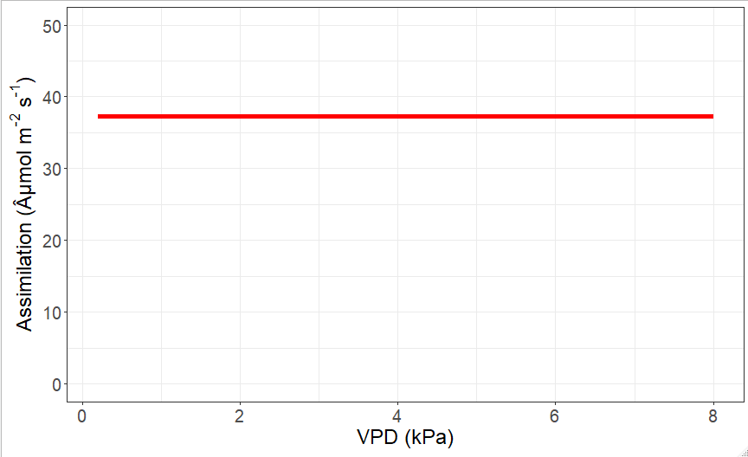
Photosynthesis Stays the Same with VPD
Food Security & Climate Change | Introduction to Photosynthesis | Modeling Acclimation | Model Applications
Helen Scott | ESA & USSEE 2019 | August 13, 2019

Slide 32
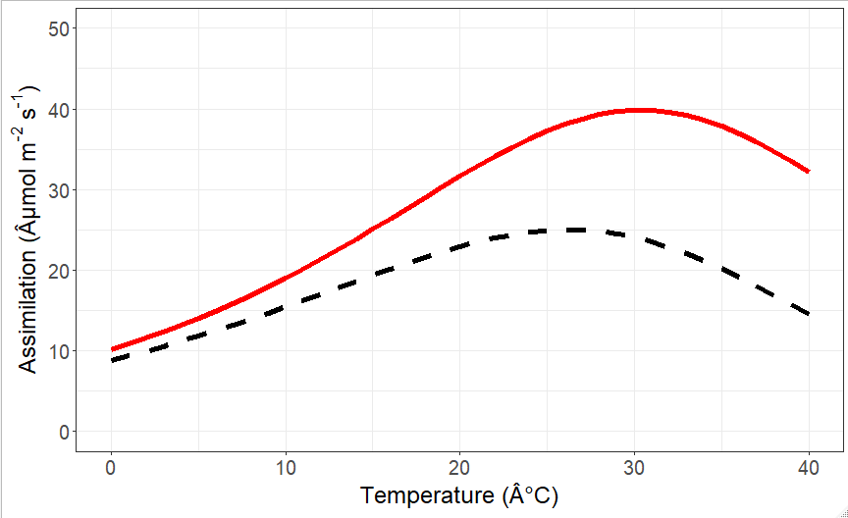
Difference between C₃ and C_{4:} ΔA

Slide 33
Difference between C₃ and C_{4:} ΔA

Slide 34
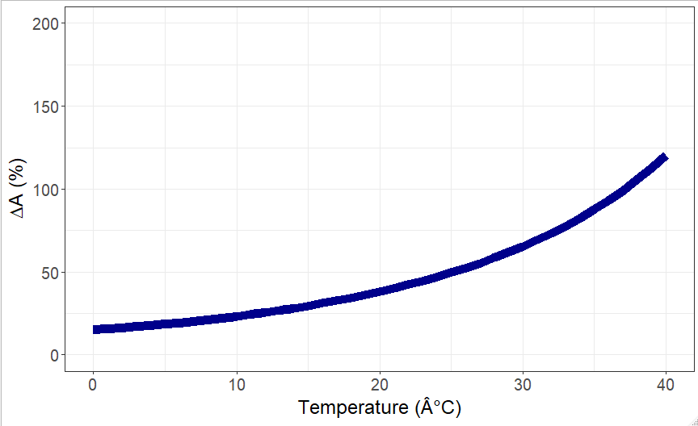
ΔA Increases with Temperature

Slide 35
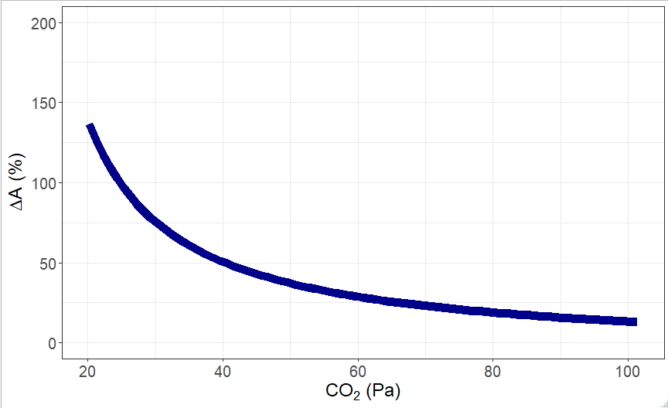
ΔA Decreases with CO₂

Slide 36
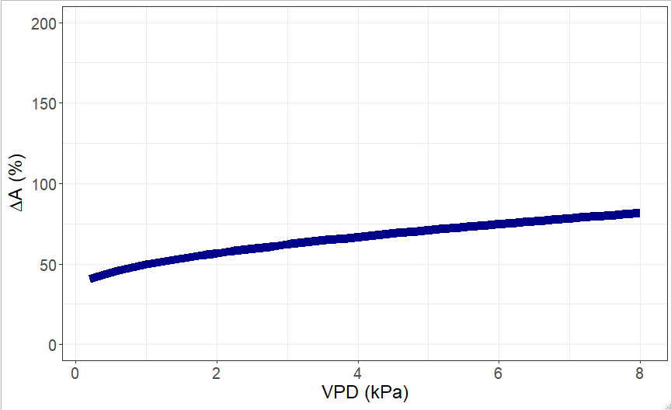
ΔA Increases with VPD

Slide 37
Global Distribution of Current ΔA
PLACEHOLDER

Slide 38
Model Validation
PLACEHOLDER

Slide 39
Model Validation
PLACEHOLDER

Slide 40
Global Distribution of Future ΔA
PLACEHOLDER

Slide 41
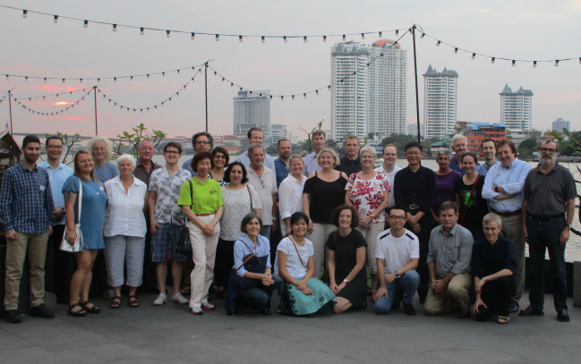

C₄ Rice
Food Security & Climate Change | Introduction to Photosynthesis | Modeling Acclimation | Model Applications
Furbank & Von Caemmerer: Australian National University, Canberra
Helen Scott | ESA & USSEE 2019 | August 13, 2019

Slide 42
Making C₃s more like C₄s
Food Security & Climate Change | Introduction to Photosynthesis | Modeling Acclimation | Model Applications
Helen Scott | ESA & USSEE 2019 | August 13, 2019

Slide 43
Global Distribution of Future ΔA
PLACEHOLDER

Slide 44
How can We Improve ESMs?

Slide 45
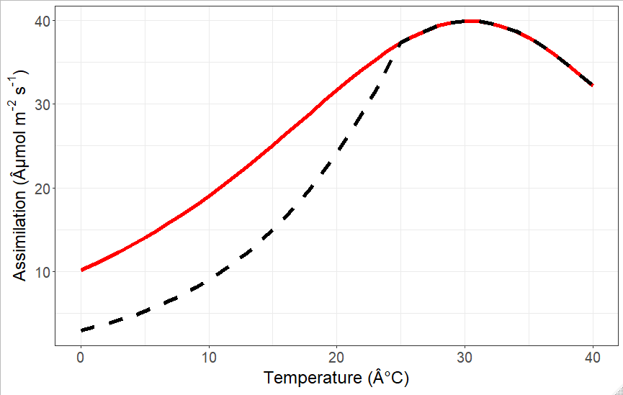
How can We Improve ESMs?
Food Security & Climate Change | Introduction to Photosynthesis | Modeling Acclimation | Model Applications
Helen Scott | ESA & USSEE 2019 | August 13, 2019

Slide 46
Conclusions
Food Security & Climate Change | Introduction to Photosynthesis | Modeling Acclimation | Model Applications
C₄ Photosynthesis is Important
C₄ Photosynthesis Acclimates
Including Acclimation will make ESMs more Accurate
Acclimation may change geographic regions where C₄s win
Helen Scott | ESA & USSEE 2019 | August 13, 2019

Slide 47

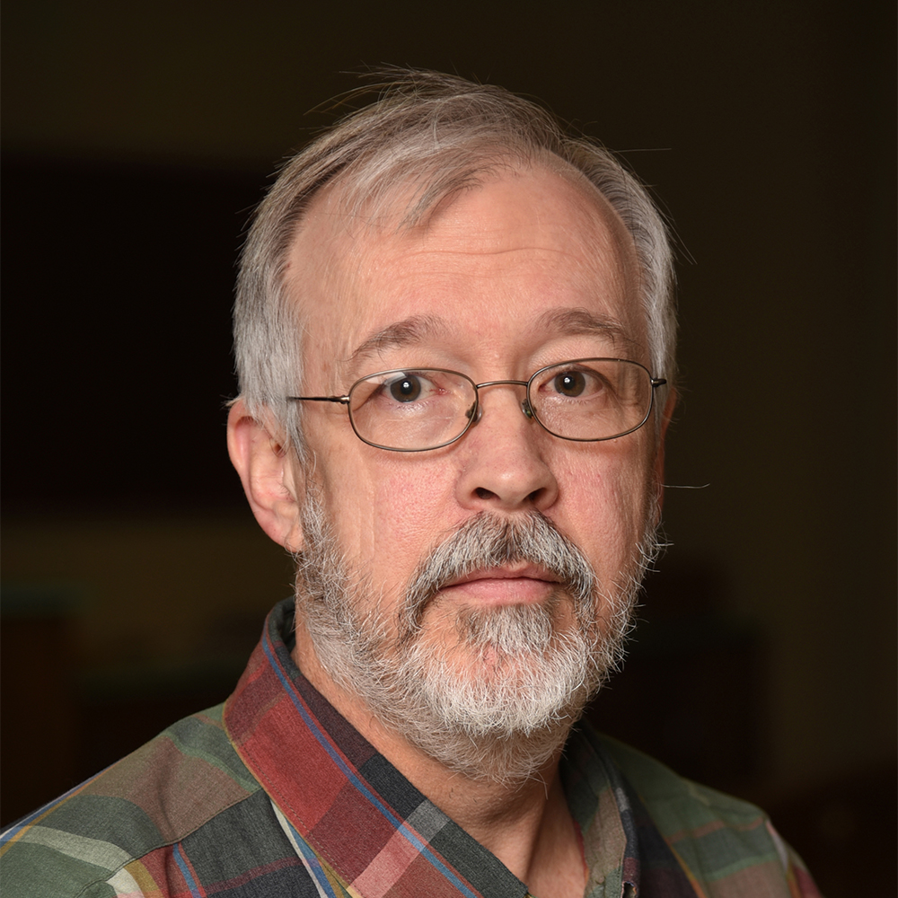
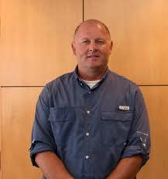



Acknowledgments
Helen Scott | ESA & USSEE 2019 | August 13, 2019

Slide 48
Stomatal Conductance
Food Security & Climate Change | Introduction to Photosynthesis | Modeling Acclimation | Model Applications
CO₂in the plant
CO₂ in the air
= χ
Helen Scott | ESA & USSEE 2019 | August 13, 2019

Slide 49
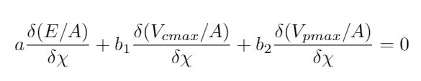
Stomatal Conductance
Food Security & Climate Change | Introduction to Photosynthesis | Modeling Acclimation | Model Applications
Helen Scott | ESA & USSEE 2019 | August 13, 2019

Slide 50
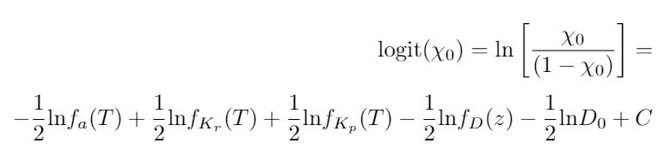
Stomatal Conductance
Food Security & Climate Change | Introduction to Photosynthesis | Modeling Acclimation | Model Applications
Helen Scott | ESA & USSEE 2019 | August 13, 2019

Slide 51
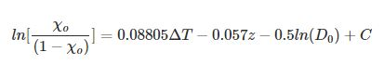
Stomatal Conductance
Food Security & Climate Change | Introduction to Photosynthesis | Modeling Acclimation | Model Applications
Helen Scott | ESA & USSEE 2019 | August 13, 2019

Slide 52
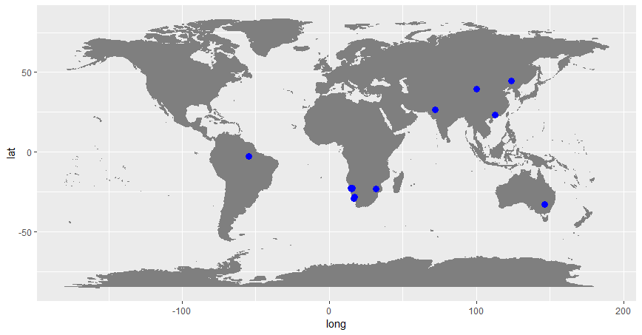
Stomatal Conductance
Food Security & Climate Change | Introduction to Photosynthesis | Modeling Acclimation | Model Applications
Helen Scott | ESA & USSEE 2019 | August 13, 2019

Slide 53
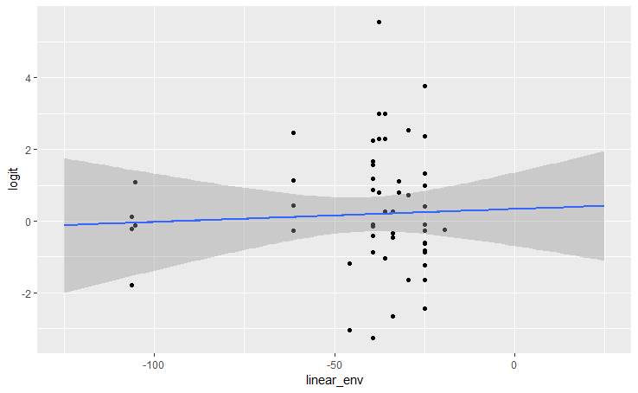
Stomatal Conductance
Food Security & Climate Change | Introduction to Photosynthesis | Modeling Acclimation | Model Applications
Helen Scott | ESA & USSEE 2019 | August 13, 2019

Slide 54
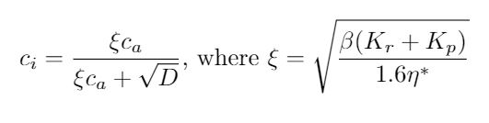
Stomatal Conductance
Food Security & Climate Change | Introduction to Photosynthesis | Modeling Acclimation | Model Applications
Helen Scott | ESA & USSEE 2019 | August 13, 2019

